Slide 1
Permit to Work System
TDI-Brooks International
Aug 2020

Slide 2
Instructors
Hand out quizzes to students
Students complete the quiz during the PowerPoint
Quiz answers are tagged with:

Slide 3
Basics
TDI-Brooks’s permit to work system is described in the SMM in SOP-GEN-019
A permit to work system is a formal written system used to control POTENTIALLY HAZARDOUS WORK.

Slide 4
The 5 Why’s of a Permit
Why do we have to write permits?
Federal Law requires a written permit for potentially dangerous work.

Slide 5
The 5 Why’s of a Permit
Why did they make it a law?
Because while many people die on the job each year, these activities have the highest fatality rates.

Slide 6
The 5 Why’s of a Permit
Why did more people die doing this type of work?
Because the workers are exposed to greater hazards.

Slide 7
The 5 Why’s of a Permit
Why weren’t they more careful to work safely?
Because they didn’t recognize the hazards or were so used to them that they became complacent.

Slide 8
The 5 Why’s of a Permit
Why would they allow themselves to become complacent if it was so dangerous?
Fatigue, rushing to finish the job, frustration, didn’t think it was important, nothing bad had happened before.

Slide 9
Permits and Risk Assessment
The permit isn’t the point!
The point is to slow down,
recognize the risks and
have a plan to protect yourself and others.

Slide 10
Permitted Work
TDI-Brooks requires a permit for:
Hot Work
Working at Heights (crewman’s feet over 6 ft off the deck)
Energy Isolation
Confined Space

Slide 11
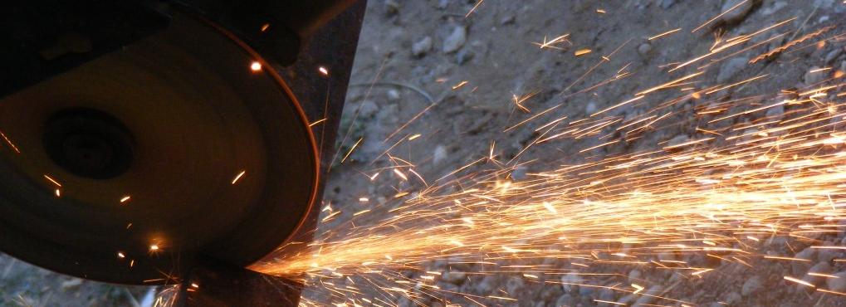
Definitions
Hot Work- (29 CFR 1915)
“Any riveting, welding, burning, or other fire or spark producing operations”
If it produces a spark, it needs a permit

Slide 12
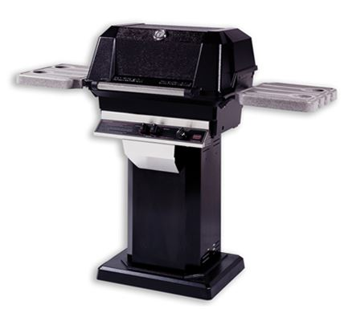
Exception: BBQ Grill
Barbeque Grills
Grills on our vessels are fixed to the deck in an area designated for that activity. No permit is required for grilling in the designated grilling area.

Slide 13
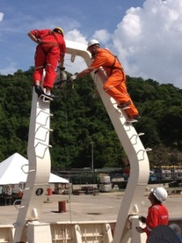
Definitions
Working at Heights
Any work Where the worker’s feet are 6 feet or more above the deck
Fall protection must be worn unless a risk assessment determines that it would create a greater hazard.

Slide 14
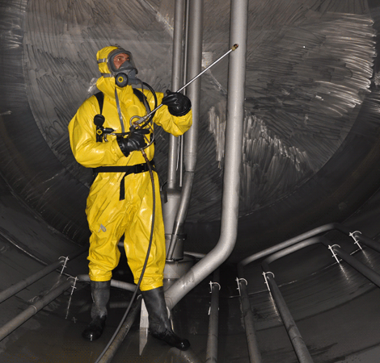
Definitions
Confined Space
Any entrance into a registered permit-required confined space on the vessel
Confined Spaces on all vessels are listed in the SMM.

Slide 15
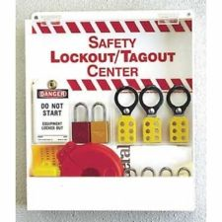
Definitions
Energy Isolation (Lockout/ Tagout )
29 CFR 1915
Required to prevent activation of equipment or release of stored energy that could harm a person

Slide 16
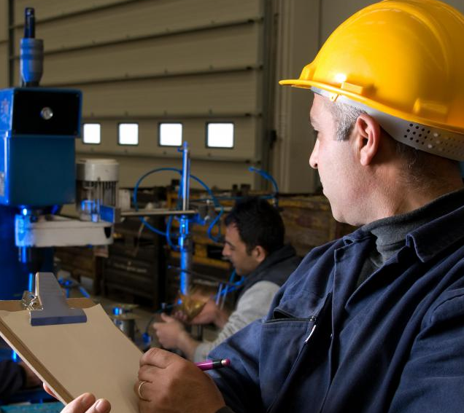
Authorized Persons
The person empowered by TDI to approve and sign a permit

Slide 17
Authorized Persons
Working at Heights-
Master/ Mate
Energy Isolation or Hot Work- Chief Engineer

Slide 18
Definitions
Authorized Persons: (SMM)
Confined Space- Must be signed by BOTH Master & Chief Engineer

Slide 19
Definitions
Alternate Authorized Persons
The Port Engineer may authorize any permit when a Master, Mate or Chief Engineer is not available

Slide 20
Risk Assessment
Before performing a task, you need to assess the risks.
A Job Safety Analysis (JSA) is integrated into each permit and should include a rescue plan for the worker if needed.

Slide 21
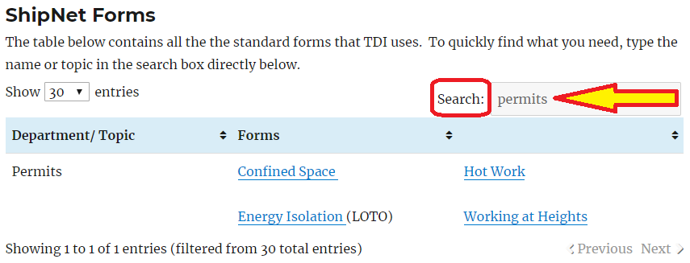
Where to find permits
Permits are located on the ship web pages on the ShipNet Forms page.

Slide 22
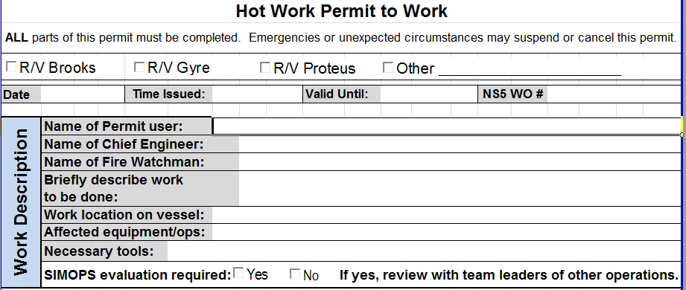
Work Description
Fill out ALL info

Slide 23
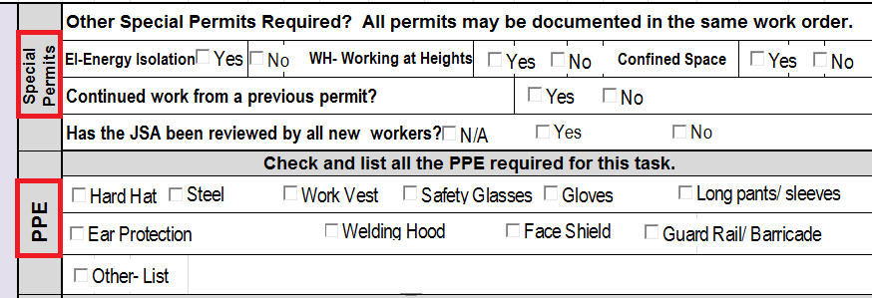
Special Permits & PPE
More than one permit may be needed.
Shift change is documented in this section
PPE is documented next

Slide 24
Risk Assessment
The people who will be doing the work (including contractors) are to conduct Job Safety Analysis (JSA) under the direction of the person supervising the work.

Slide 25
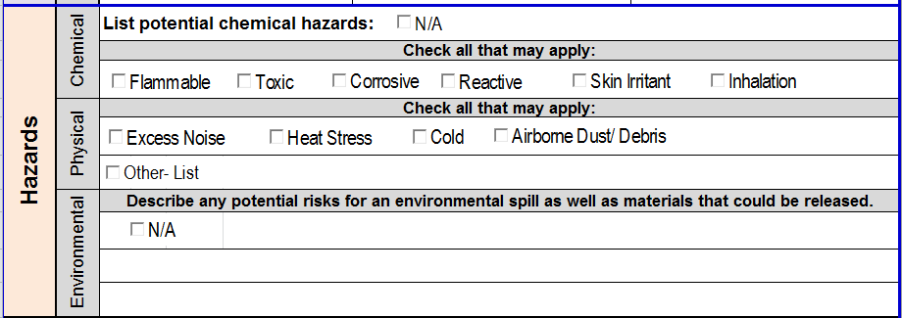
Hazards
The section below the JSA will include a list of potential hazards and controls to mitigate them.
Weather and sea state would be included here.

Slide 26
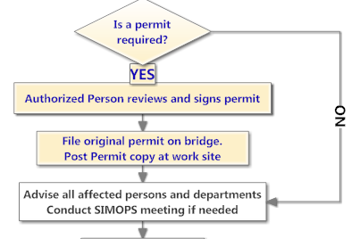
AFTER the JSA–
Authorized Person Signs
Post Copy at work site/ Original on Bridge
SIMOPS meeting if needed

Slide 27
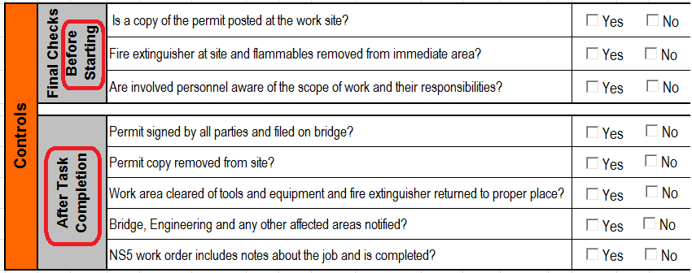
Controls
Controls apply both before work begins AND after work has been completed.

Slide 28
Controls
Based on the pre-start controls, which type of permit is this?
After completing all the previous steps and final checks before starting, you may BEGIN WORK.

Slide 29
12 Hour Rule
Permits are only good for 12 hrs.
If work will continue after the 12 hrs, a new permit must be issued.
** Exception for Energy Isolation. It may take weeks to get a part in. A single EI permit will suffice until the repair can be made.

Slide 30
Change of Shift
If permitted work crosses into the change of shift, the new workers must complete a new permit, but can review the JSA from the previous permit.
So– New shift workers = new permit
But- can use the previous shift’s JSA - as long as it is reviewed with all new workers

Slide 31
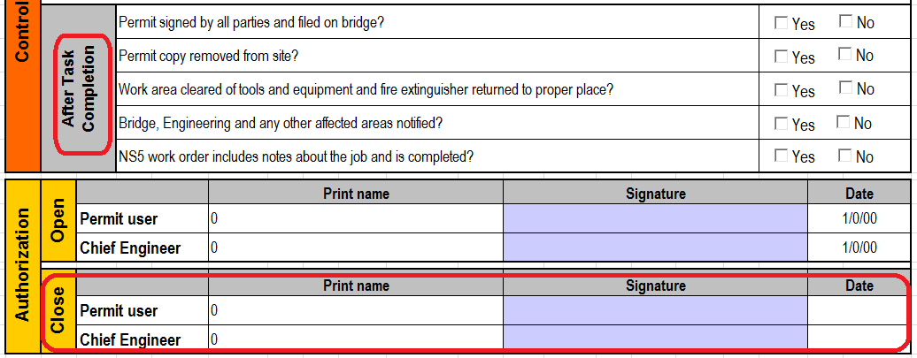
When work is complete… the paperwork continues
When work is finished, you must complete the After Task Controls and the
Authorized Person must sign that the job is complete and create a task in Helm for it.

Slide 32
Finally!
When all of these steps are completed, you are done!
Make sure the correct copy is filed on the bridge–( the one with all the final checks and signatures)

Slide 33
Questions?
Instructors-
Scan sign in sheets and quizzes and email to HSE@tdi-bi.com. If files are too big, hand carry files or paper copies to office
Make physical copies and give to bridge crew to file in Binder #11
Return originals to students
Notes:
Answer any questions and distribute the quiz.

