Slide 1
Risk Analysis & HAZID
TDI-Brooks International
Rev Aug 2020

Slide 2
Instructors
Hand out quizzes to students
Students complete the quiz during the PowerPoint
Quiz answers are tagged with:

Slide 3
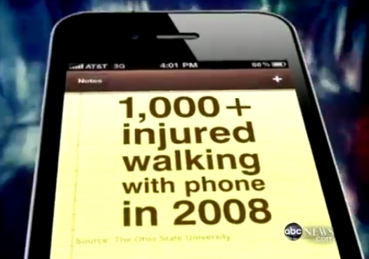
Situational Awareness
You are exposed to dangers every day– but do you recognize them?

Slide 4
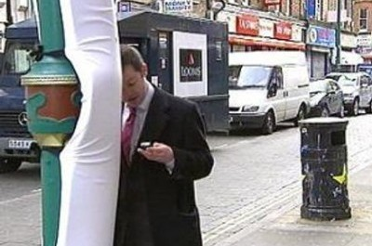
Situational Awareness
So many people get injured because they are not paying attention to where they walk that cities have had to “idiot proof” common obstacles.

Slide 5
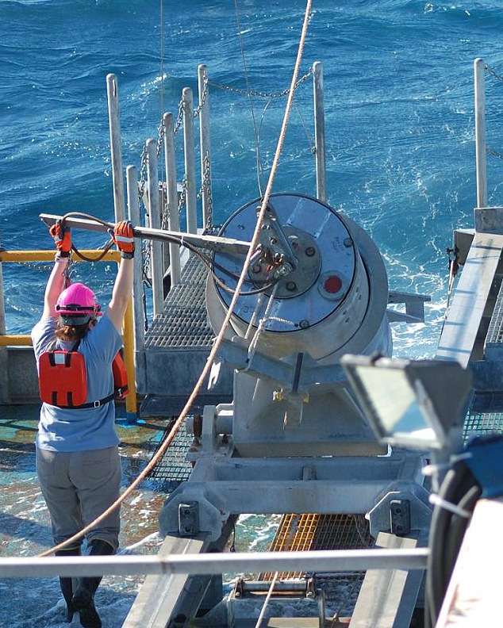
Situational Awareness
You work offshore on a moving vessel in all types of weather.
How much more dangerous is your job?

Slide 6
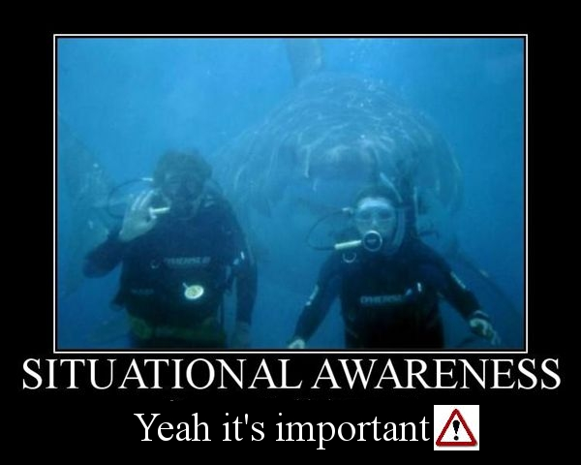
Situational Awareness just means being aware of what’s going on around you- especially when something changes.

Slide 7
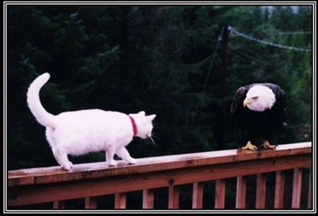
Situational Awareness
Some lessons can only be learned once…

Slide 8
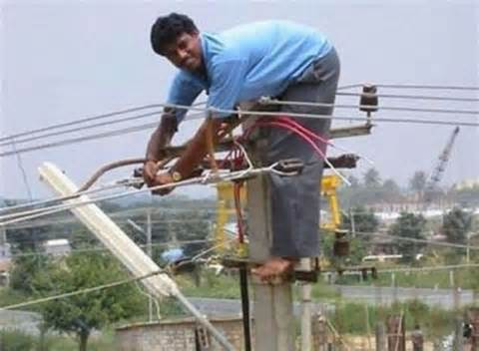
Analyze the Risk
Before beginning any task, you need to STOP and analyze the risks.

Slide 9
Hazard or Risk?
Hazard is any potential for harm (to yourself, environment or equipment)
Risk = Hazard + Exposure
If there is no exposure, then there is no risk.

Slide 10
Hazard or Risk?
The radiation inside a nuclear reactor is a fatal hazard.
If you are not exposed to the radiation, there is no risk.

Slide 11
Analyzing Risk
An x-ray machine at the hospital also contains radiation (hazard).

Slide 12
Analyzing Risk
An x-ray machine at the hospital also contains radiation (hazard).
To take an x-ray, you must expose the patient to a low level of radiation. (exposure)

Slide 13
Analyzing Risk
An x-ray machine at the hospital also contains radiation (hazard).
To take an x-ray, you must expose the patient to a low level of radiation. (exposure)
Hazard + Exposure = Risk

Slide 14
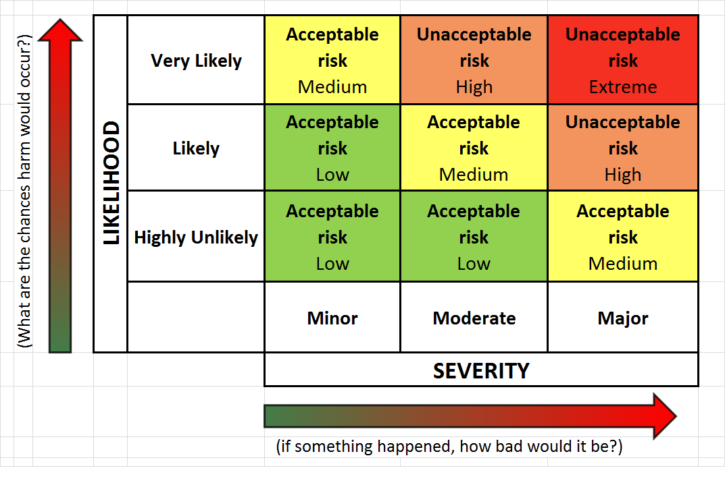
Likelihood vs. Severity
Risks are rated by likelihood (probability) and severity of potential consequences.

Slide 15
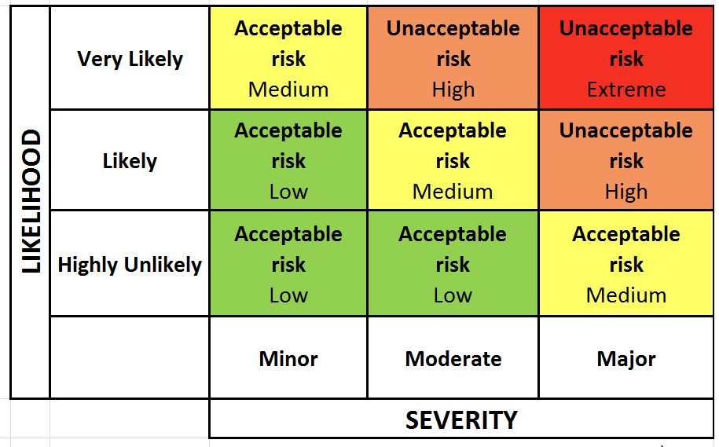
Radiation Exposure
A few exposures (likely) to low level radiation (x-rays) is not harmful. (minor)
Likely + Low severity = Acceptable risk

Slide 16
Radiation Exposure
A single exposure (highly unlikely) to high level radiation is very harmful. (major)
Low probability + High severity = Medium risk

Slide 17
Radiation Exposure
Daily exposure (likely) to high level radiation is very harmful. (major)
Welders are exposed almost daily to high levels of UV light produced by electric arcs.
High probability + High severity = Extreme risk

Slide 18
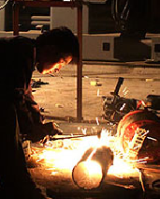
Radiation Exposure
Extreme risk is unacceptable.
The risk must be reduced to an acceptable level

Slide 19
How to Reduce the Risk?
To reduce risk, you have to reduce the probability or the severity.
A welder must be exposed to the hazard of UV radiation in order to work. Removing the exposure is not an option.

Slide 20
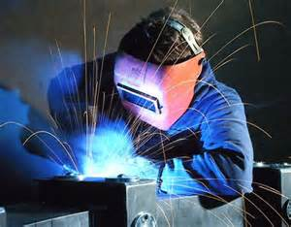
How to Reduce the Risk?
Reducing the exposure is an option
A welding hood significantly reduces the amount of UV radiation that reaches the eyes.

Slide 21
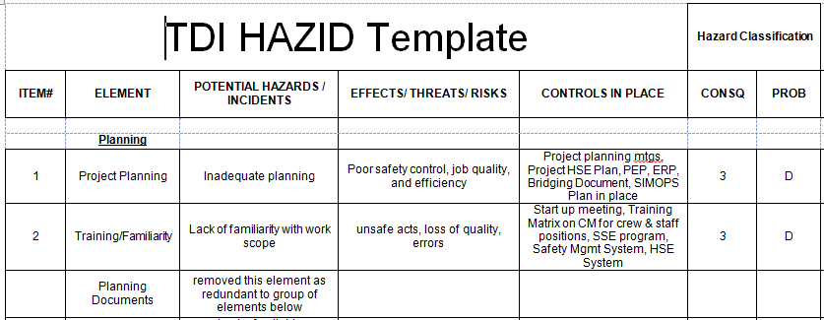
Hazard Identification (HAZID)
Before starting a job, TDI-Brooks works with the client to develop a Hazard Identification or HAZID.
A sample HAZID is on the TDI Forms page.

Slide 22
What a HAZID Analyzes
The standard HAZID reviews all the potential risks associated with planning and executing the project.
The HAZID is a review of the BIG PICTURE– or the project as a whole.

Slide 23
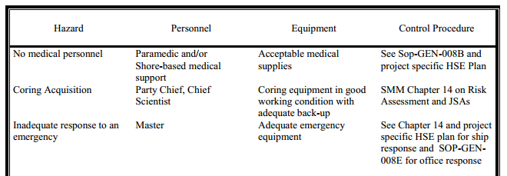
What a HAZID Analyzes
It also lists mitigations for every hazard from travelling to the boat, to how samples are collected, required PPE and what to do in case of an oil spill or MEDEVAC.

Slide 24
Job Safety Analysis (JSA)
Risk for specific tasks are assessed in the form of a Job Safety Analysis or JSA.
It is a smaller version of the HAZID:
JSA lists the steps to complete the task
JSA lists the risks related to each step
JSA lists the PPE, procedures and other mitigations to minimize those risks

Slide 25
JSAs on Crewing Module
Templates for survey and coring activities JSAs are on the Crewing Module just under the boat name.
These are just starting points, they should be reviewed and updated
every time they are used.

Slide 26
JSAs in Permit Work
For any work requiring a permit, the JSA is integrated into the permit.

Slide 27
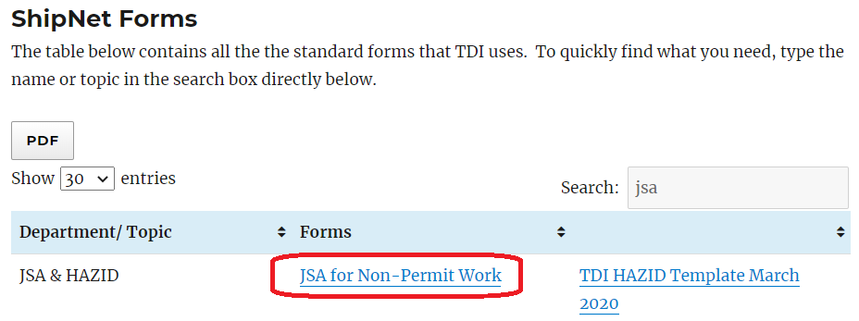
JSAs For Non Permit Work
For work that does not require a permit, there is a blank JSA template on the ShipNet Forms page.

Slide 28
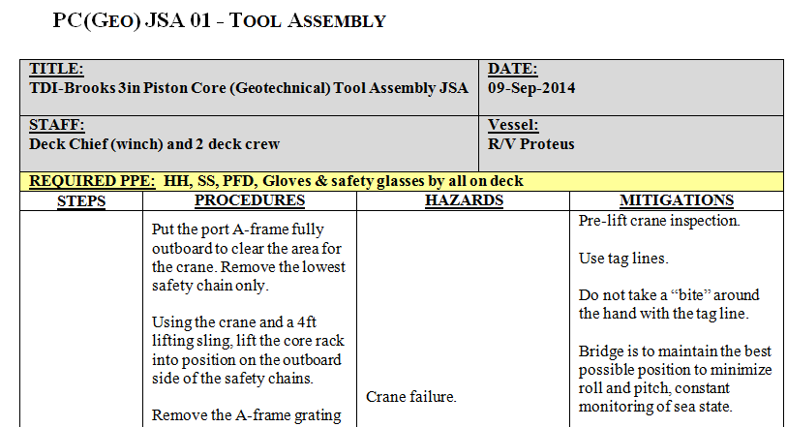
Review JSAs Every Time
Review the JSA every time before you do that task. Situations or conditions may have changed.

Slide 29
STOP WORK Authority
ANY employee, regardless of position or experience with the company, is empowered, encouraged and expected to
STOP WORK
if he feels anything is unsafe, or if he is unsure of his role/ responsibilities regarding an operation.

Slide 30
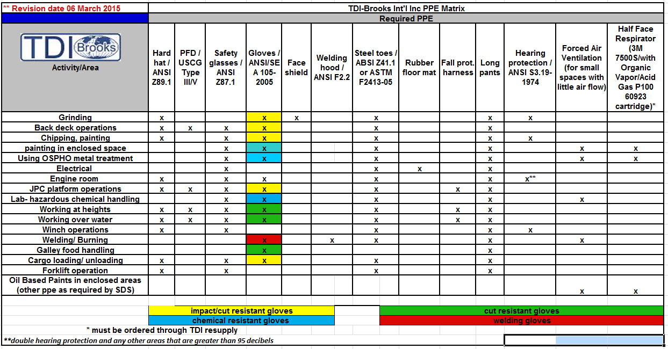
PPE Matrix
The PPE matrix tells you what PPE is required for common tasks.

Slide 31
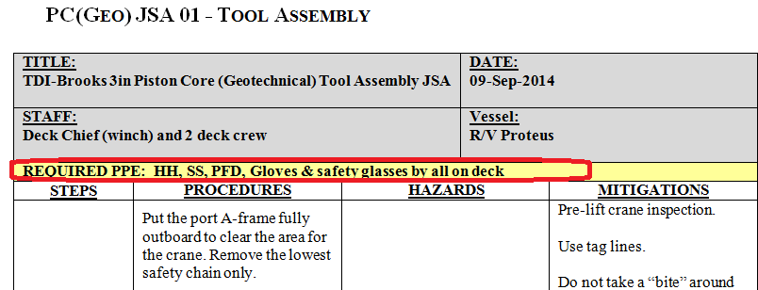
PPE
The JSA team will determine what PPE is needed for a specific task.

Slide 32
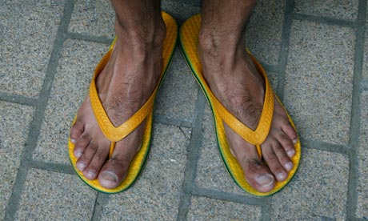
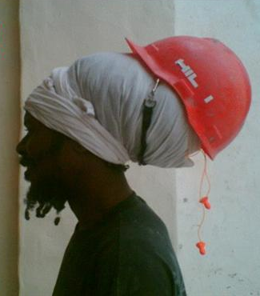
STOP WORK Situations
Someone not wearing correct PPE or not wearing it correctly? STOP WORK!!

Slide 33
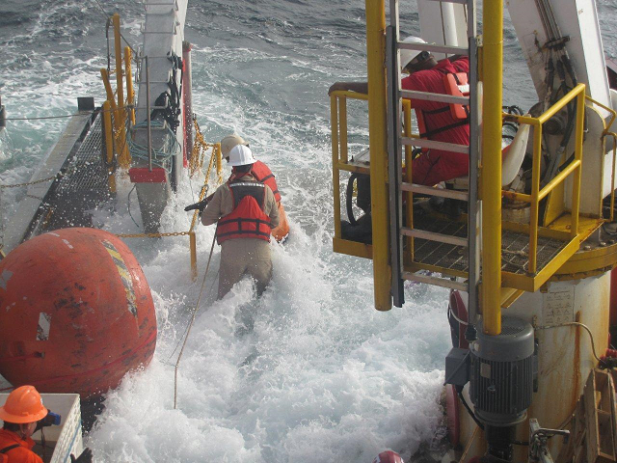
STOP WORK Situations
Someone putting themselves at obvious risk? STOP WORK !!

Slide 34
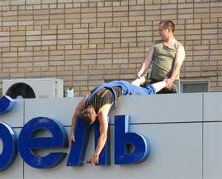
STOP WORK Situations
Someone not following procedures?
STOP WORK

Slide 35
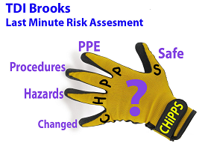
Last Minute Risk Assessment
TDI has a Last Minute Risk Assessment (LMRA) Just before you begin to work, ask yourself 5 questions:

Slide 36
Has anything CHANGED?
What are the HAZARDS?
Am I following PROCEDURES?
Am I wearing proper PPE?
How will I stay SAFE?

Slide 37
Questions?
Instructors-
Scan sign in sheets and quizzes and email to HSE@tdi-bi.com. If files are too big, hand carry files or paper copies to office
Make physical copies and give to bridge crew to file in Binder #11
Return originals to students
Notes:
Answer any questions and distribute the quiz.

