Slide 1
OIL RECORD BOOK ENTRIES

Slide 2
Instructors
Hand out quizzes to students
Students complete the quiz during the PowerPoint
Quiz answers are tagged with:

Slide 3
Goals of this training course:
Help Chief Engineers to become familiar with:
Why an accurate Oil Record Book (ORB) is important
Latest changes to entry requirements
Proper codes for procedures
How to use the TDI ORB Cheat Sheet

Slide 4
Where it starts: IMO
The International Maritime Organization (IMO) is a specialized agency of the United Nations.
It sets global standards for safety, security and environmental performance of the international shipping industry.

Slide 5
IMO created MARPOL
MARPOL is a convention (set of standards) created to prevent pollution of seas and oceans worldwide.
There are currently 6 Annexes
(or sections) each dealing with
a different type of pollution.

Slide 6
MARPOL – The Annexes
Annex I: Oil Pollution
Annex II: Noxious liquids in bulk (harmful, poisonous or unpleasant)
Annex III: Harmful Substances in packages
Annex IV: Sewage
Annex V: Garbage
Annex VI: Air Pollution

Slide 7
MARPOL – Annex I
Annex I: Oil Pollution
Covers anything to do with potential oil pollution in the water, such as:
Bunkering (On or off the vessel)
Oily waste disposal
Oily Water separator failures
Accidental spills in the water

Slide 8
MARPOL – Annex I- Compliance
The main ways an inspector can see if a vessel is following MARPOL procedures are:
Inspect the Oil Record Book (ORB)
Check that overboard discharge seals are used properly and in place in port
Look for “magic pipes” that would pump oil pollution directly into the water

Slide 9
Oil Record Book Red Flags
Incomplete or unsigned entries
Use of incorrect codes/ format/ units
TDI uses cubic meters (m3) for all entries
Math doesn’t add up (Oil is ‘missing’)
Sloppy entries, white out/ scratch outs
BLANK LINES

Slide 10
ORB Red Flags could indicate…
Officers are illegally dumping oil pollution
Officers are “hiding” fuel and selling it for personal profit
Officers are entering false numbers to make it appear the vessel is operating better than it is

Slide 11
What this means to you
Fines can be charged for the APPEARANCE of wrongdoing and incomplete records
Vessel can be detained by Port State
Licensed Officers are PERSONALLY fined, criminally charged or both
$8,000 USD for each false statement
$40,000 USD per violation per day
Officers license suspended or revoked

Slide 12
Oil Record Book- Purpose
Accounts for Oil and Oil Residues –
Cradle to Grave
Bunkering (Fuel and Lube)
Used Oil & Sludge within the vessel
Oily Water storage, treatment, discharge
Ultimate disposal ashore
Accidental Releases
Equipment Malfunctions

Slide 13
Vanuatu Oil Record Book
Vanuatu has its own custom ORB you must use
It is the property of and returned to Vanuatu
IN INK
Requires SIGNATURES of Engineering and Bridge Officers
ACCESSIBLE at all times
UP TO DATE (current) at all times

Slide 14
And you aren’t expected to. Keep the ORB Cheat Sheet with your ORB as guidance. It contains:
You are NEVER going to
remember all this!!!
Fuel/Oil Pathways and ORB Codes
Printable posting
TDI Sample Oil Record Book Entries
Volume Conversion Tables
MEPC.1/Circ.736/Rev 2 – Oct. 6. 2011
With TDI specific notes and entry formats

Slide 15
Current copy on the TDI Forms page:
The ORB Cheat Sheet

Slide 16
ORB Codes Most common entries
H
Bunkering
C
Waste oil/ sludge
D
Oily Bilge

Slide 17
ORB Codes-
H
Bunkering
Fuel Oil 26.3
& Lube Oil 26.4

Slide 18
H=Bunkering / FUEL OIL= 26.3
Date MUST be in this format!! DD/MONTH/YYYY
26.1 Geographic location of transfer
26.2 Start and stop times
26.3 Specific type, quantity of fuel, where it was put
and ROB
Signature, Rank, DD/MONTH/YYYY

Slide 19
H=Bunkering / Lube OIL= 26.4
Date MUST be in this format!! DD/MONTH/YYYY
26.1 Geographic location of transfer
26.2 Start and stop times
26.4 Specific type, quantity of fuel, where it was put
and ROB
Signature, Rank, DD/MONTH/YYYY

Slide 20
ORB Codes-
C
Waste oil/
sludge
(C) 11.1 This code is for
collection of “oil residues” generated aboard, such as residues resulting from drainage, leakages, exhausted oils etc.
C 11= Collection
C 12= Disposal

Slide 21
ORB Codes-
C
Waste oil/
sludge
Weekly Inventory must be entered
(even if no activity or tank is empty)
Used oil/ sludge (NOT oily bilge water)
Each addition or transfer
Oil/ sludge to shore facility
***Does NOT include fuel burned or oil consumed by vessel

Slide 22
C 11=Oily Residues – to used oil tank
Date MUST be in this format!! DD/MONTH/YYYY
11.1 location residue was transferred to
11.2 Tank Capacity
11.3 New ROB (previous ROB + what was added)
11.4 Amount of new oil and where added
Signature, Rank, DD/MONTH/YYYY
Always end entry with Signature, Rank and Date!!

Slide 23
C 11=Oily Residues – to used oil tank
Date MUST be in this format!! DD/MONTH/YYYY
11.1 location residue was transferred to
11.2 Tank Capacity
11.3 New ROB (previous ROB + what was added)
11.4 Amount of new oil and where added
Signature, Rank, DD/MONTH/YYYY
Previous ROB of 1.1 M3
+ the added 0.56 M3 = a NEW ROB of 1.66 M3

Slide 24
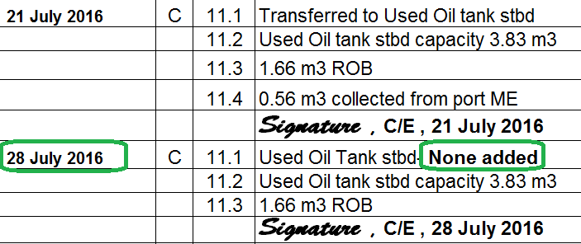
C 11=Oily Residues – Weekly Update
Weekly update with NO CHANGES
11.1 location of residue
11.2 Tank Capacity
11.3 Maintained ROB
**Weekly update required even if tank is empty!!

Slide 25
C 12.1 =Oily Residues – Disposal
**For TDI vessels, the only legal way to dispose of oil residue is to a shore reception facility. This could be a terminal, barge, offloading vessel or a truck.
12.1 Amount removed, from what tank, amount ROB
Receiver’s name, name of port

Slide 26
ORB Codes-
D
Oily Bilge
(Manual transfer) Bilge to Slop Tank

Slide 27
ORB Codes-
D
Oily Bilge
(Manual transfer) Bilge to Slop Tank
Previous ROB 1.5 M3
+ added 3.03 M3 =
NEW ROB of 4.53 M3

Slide 28
ORB Codes-
D
Oily Bilge
Slop tank through OWS
Then discharged overboard

Slide 29
MARPOL Annex I Bottom Line – No oily residue enters the ocean except after passing thru 15 ppm filtering equipment – OWS No Possible Appearance of a pathway except thru OWS

Slide 30
SPECIAL NOTE: If you pumped directly from the bilges through the OWS and then overboard, you probably will not have an accurate sounding of how much you pumped.
In this case, your entry should be a GOOD FAITH ESTIMATE, based on the processing capabilities of the OWS.
YOU MUST NOT enter an amount in the Oil Record Book that exceeds the capacity of the OWS!!!

Slide 31
ORB Codes-
D
Oily Disposal
Slop tank or Bilge
to shore facility

Slide 32
ORB Codes-
D
Oily Disposal
Slop tank or Bilge
to shore facility
This number MUST match the number on your receipt.
Sound tanks BEFORE discharging to ensure your numbers are accurate.
Keep receipt with ORB

Slide 33
Special Entries Codes-
G- Accidental pollution
F- OWS Failure/ Repair
I- Irregularity
Missed entry or error entry
Sealing/ Unsealing OWS overboard discharge valves
Debunkering of Fuel Oil

Slide 34
Accidental or exceptional discharge of oil or oily waste
Code G- 22 Time of occurrence
23 Place, location of ship
24 Approx Quantity
25 Circumstances, reasons, remarks
May require implementation of SOPEP or NTVRP
Does require ---immediate report to DPA
filing USCG form 2692 or Vanuatu Vessel Casualty Report

Slide 35
ORB Codes-
Code F- Oily water separator
Failure
F19- When broken
F21- Reason for failure (if known)
I- If not immediately repaired, seal the overboard discharge valve

Slide 36
ORB Codes-
Code F- Oily water separator
Repair
F20- When repaired
F21- Reason for failure (if known)
I- unseal the overboard discharge valve

Slide 37
I=DeBunkering / FUEL OIL
Extremely rare-
Ask Port Engineer for guidance.
And see ORB Cheat Sheet for how to enter.

Slide 38
MARPOL Annex I Pumping, Piping, Discharge arrangements for Oily Water
Slop tank – oily bilge water
Used oil tank – used oil, sludge
Oily Water Separator (OWS)
15 ppm
Auto cutoff, alarm
ONLY discharge route overboard
Standard Discharge Connection (weather deck)- Reg 19
Reg 17.3- no direct connection from sludge/slop tanks overboard that bypasses the oily water separator. These are called “Magic Pipes” and are illegal

Slide 39
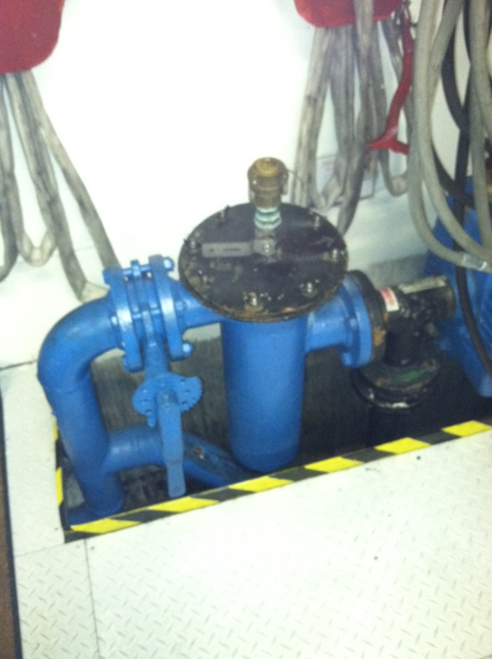
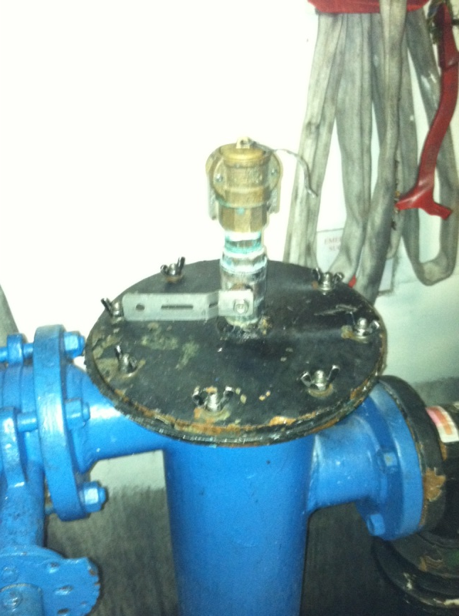
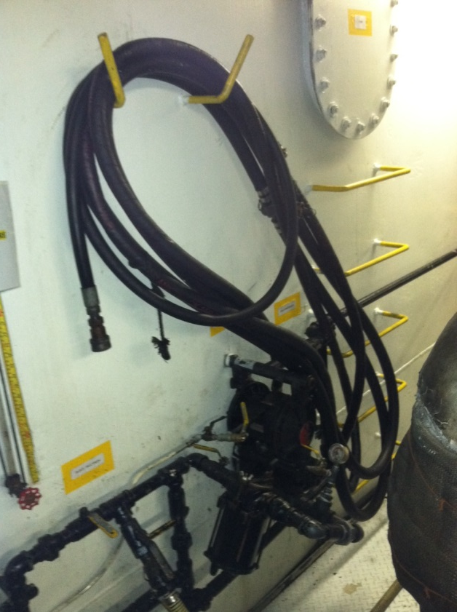
Under no circumstances should there be a connection to and overboard discharge from an engine room bilge or sludge pump other than the standard discharge connection to the deck required by Marpol 19, and if such connection exists the fact should be assessed as high risk. Marpol Reg 17.3

Slide 40
D= is always BILGE WATER
There are three numbered subcategories. These are:
13 – Quantity Disposed of (What, How Much)
14 – Time at start and stop of transfer (When)
15 – Method of Disposal. (Where)
D-15.1 Pumped overboard through the OWS
D-15.3 You must record the amount every time you pump bilge water to a tank on the vessel.
D-15.2 Pump your bilge ashore to a reception holding tank/ facility.

Slide 41
D= is always BILGE WATER
Any disposal of bilge water overboard must be through an approved Oily Water Separator (OWS).
If you transfer bilge water to a cargo slop tank, you must still use the correct code for the disposal of BILGE WATER (D) [Not C- that is for oily sludge)

Slide 42
D-13 How will you know how much bilge water you pumped into the holding tank?
Sound the tanks before and after pumping bilges to the tank, to determine how much you have pumped.
The math MUST add up!
Although the ORB instructions do not say so, you SHOULD record how much is in the bilge holding tank at the finish of transfer.
Now you transfer 100 gallons from the bilge well to the holding tank. You know you transferred 100 gallons because you sounded the holding tank before and after, right?

Slide 43
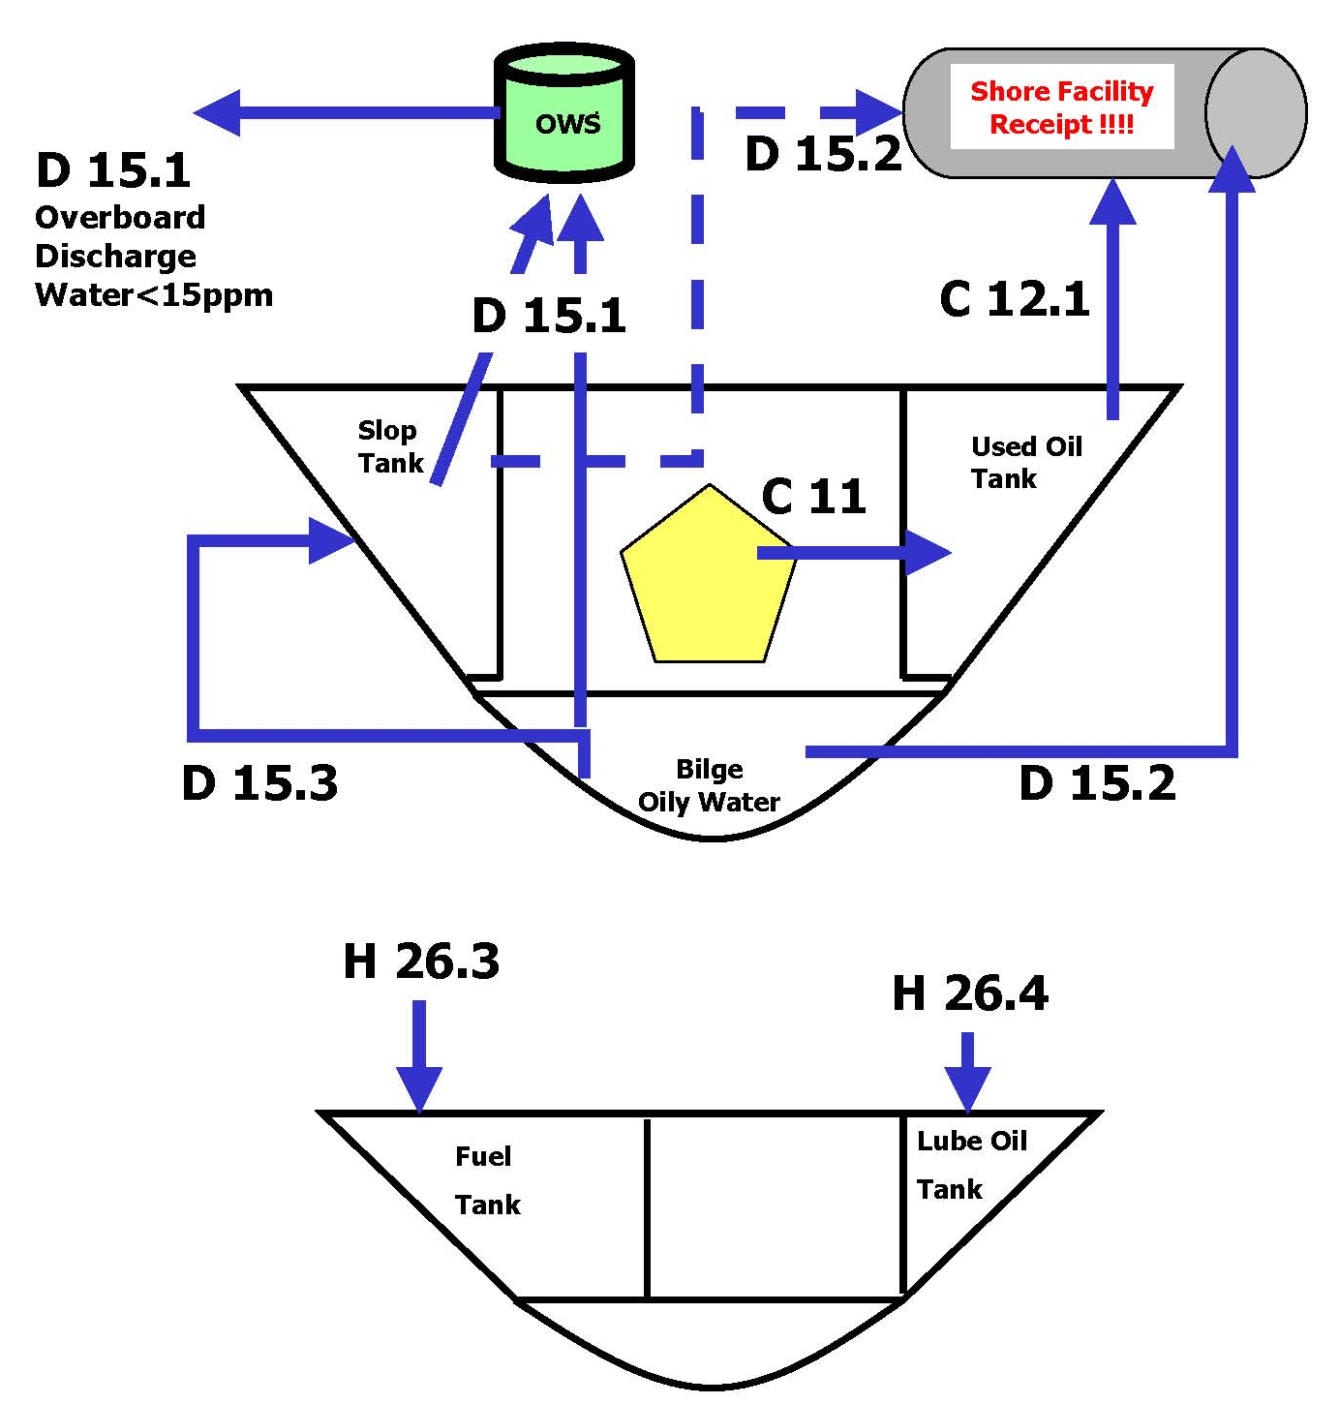
Fuel Oil Pathways Chart

Slide 44
Check the ORB Cheat Sheet
Again, you are NEVER going to
remember all this!!!
Still not sure? BEFORE you guess,
write a practice entry on a blank sheet of paper. Email your proposed entry to PortEngineer@tdi-bi.com or RogerFay@tdi-bi.com for confirmation.

Slide 45
Now to apply what you’ve learned…
To get credit for this training, you must
Use the Oil Record Book Cheat Sheet to answer the ORB quiz.
Send your completed ORB QUIZ to HSE@tdi-bi.com as proof of training.
No QUIZ = NO CREDIT!!

Slide 46
Questions?
Instructors-
Scan sign in sheets and quizzes and email to HSE@tdi-bi.com. If files are too big, hand carry files or paper copies to office
Make physical copies and give to bridge crew to file in Binder #11
Return originals to students
Notes:
Answer any questions and distribute the quiz.

