Slide 1
Safety at Sea
TDI-Brooks International’s
HSE Policy Review
Revised March 2021

Slide 2
TDI HSE Commitment
It is the goal of TDI-Brooks International to conduct each project with zero accidents and no harm to personnel or the environment.

Slide 3
Management Commitment
TDI-Brooks is responsible for providing the proper equipment, tools, training, supervision and policies to their employees to meet the company commitment to a safe work environment.

Slide 4
Management Commitment
Every employee is responsible for understanding and practicing appropriate safety procedures and policies for their own protection as well as others.

Slide 5
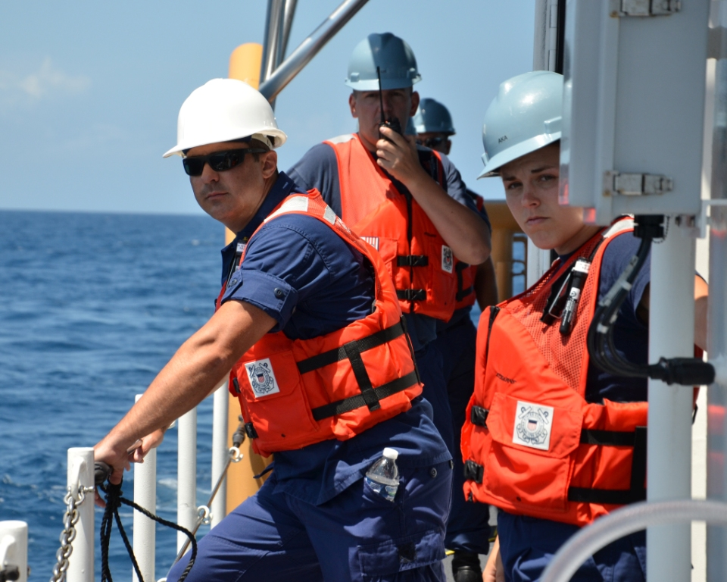
Management Commitment
Employees, contractors, clients and visitors must work together to create a safe and environmentally responsible work environment.

Slide 6
Management Commitment
TDI-Brooks maintains a Safety Management System.
The policies and procedures are located in the Safety Management Manual on each vessel.

Slide 7
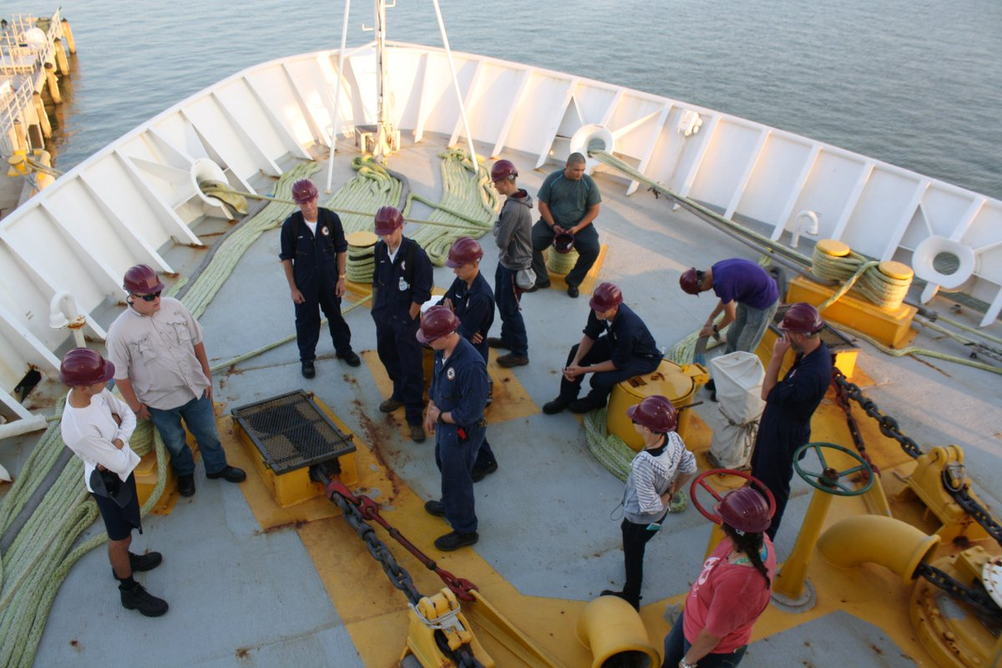
Core Safety Training
Each employee must complete training in the policies and procedures of our safety system.

Slide 8
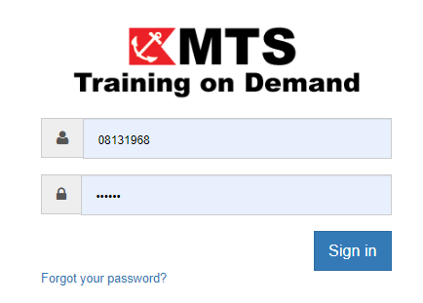
Computer Based Training
The Core Safety Training is available as computer based training courses.

Slide 9
Core Safety Training Topics
Confined Space Entry
Hazard Communication/ GHS
Hearing Conservation
Job Safety Analysis
Lifting Gear
Permit to Work System
Risk Analysis & HAZID

Slide 10
Core Safety Training Topics
Additional position specific courses may be required. These are detailed in the TDI Required Training Matrix.
The matrix is on ShipNet Forms

Slide 11
Required Training Matrix

Slide 12
Behavioral Based Safety
The goal of behavior based safety is to get each person to take ownership of his own safety and look out for the safety of others.

Slide 13
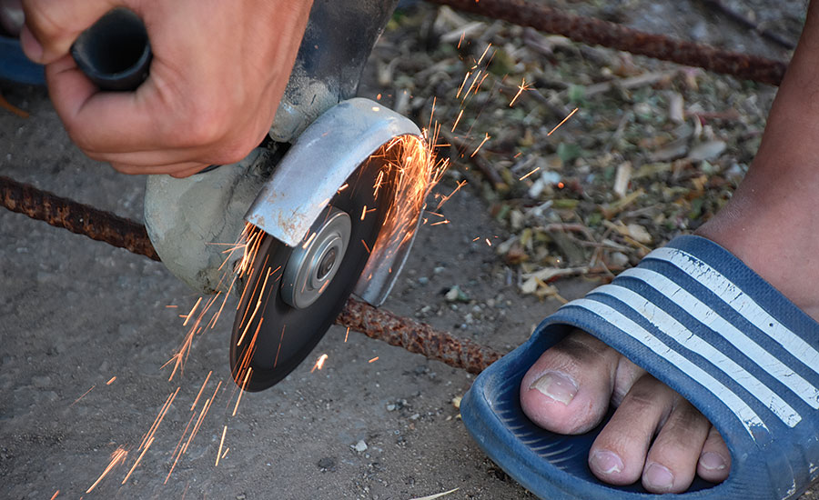
Behavioral Based Safety
If you SEE it, you OWN it,
if you IGNORE it,
you CONDONE it.

Slide 14
Behavioral Based Safety
TDI engages employees in safety in many ways. These are a few:
Safety Observation Cards
Job Safety Analysis (JSAs)
HSE Special Topic Talks
STOP WORK authority for ALL
Last Minute Risk Analysis (CHiPPS)

Slide 15
Safety Observation Cards
If you see a potential hazard that needs to be addressed. Fix it if you can (like a trip hazard- move the object)

Slide 16
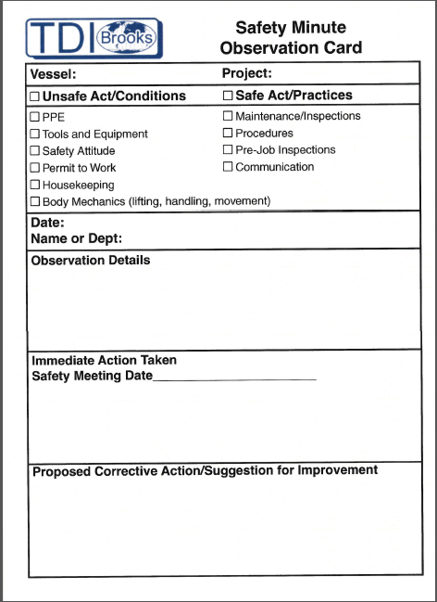
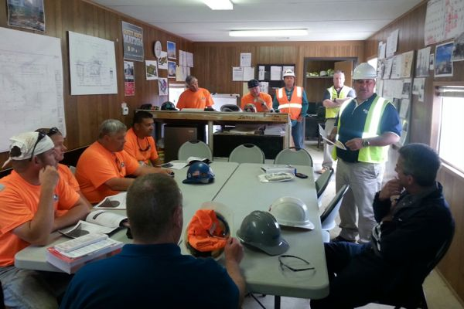
Fill out a Safety Observation Card
The Captain or Party Chief will review it at the next safety meeting.

Slide 17
Job Safety Analysis
A JSA breaks a job into steps, identifies potential hazards in each step and states how you will minimize each hazard.

Slide 18
Job Safety Analysis
Before beginning work, the supervisor and employees doing the work should review the JSA and adapt to any changing conditions or new hazards.
If a JSA does not exist for a task, one must be created by the supervisors and those doing the work

Slide 19
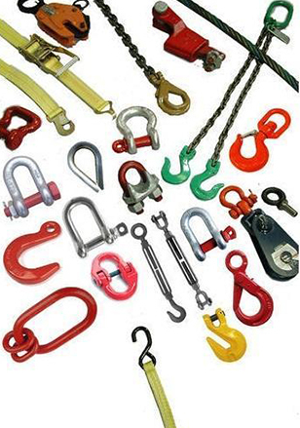
Lifting Gear SOP-GEN-020
Lifting gear is anything between the lifting appliance (crane or winch) & the load. It includes slings, blocks, pendants, shackles, harnesses and anything else used to support a load.

Slide 20
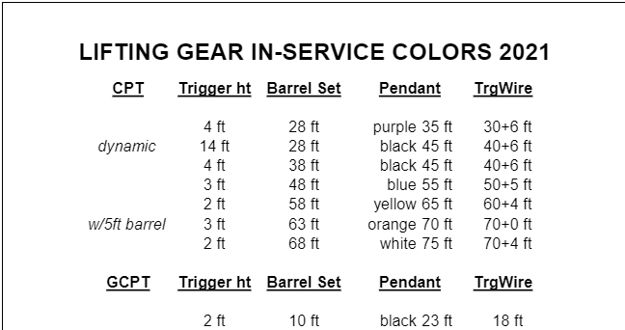
Lifting Gear Procedures
Lifting gear is inspected annually by a qualified rigger and painted the current year’s color listed on the Lift Gear Color Chart.
This year’s color is…???
Color chart should be posted near the lifting gear

Slide 21
Lifting Gear Inspections
Anyone using lifting gear is responsible for inspecting it before use.
Gear must be in good condition and painted with the current year’s color.
Damaged gear should be painted red, removed from service & quarantined below deck.

Slide 23
Permit to Work System
SOP-GEN-019
TDI requires a permit to work for:
Hot Work
Energy Isolation
Working at Heights
Confined Spaces Entry

Slide 24
Hot Work- SOP-GEN-026
Hot work includes welding, grinding, cutting/ burning or anything that makes a spark
Workers must complete the included JSA
Chief Engineer must sign
A copy of signed permit must be posted at the work site during the work

Slide 25
Energy Isolation (LOTO)
Energy Isolation prevents injuries and death by accidental start of equipment during maintenance or servicing.
Workers must complete the included JSA
Chief Engineer must sign
A copy of signed permit must be posted at the work site during the work
Equipment tested to make sure it won’t turn on before starting work

Slide 26
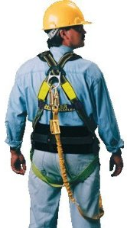
Working at Heights SOP-GEN-009
Required when worker’s feet will be 6 feet or more off the deck
Workers must complete the JSA
Master or Mate must sign
A copy of signed permit must be posted at the work site
A fall protection harness is required for working at heights.

Slide 27
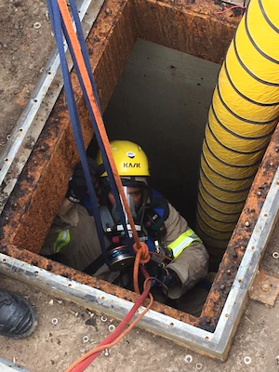
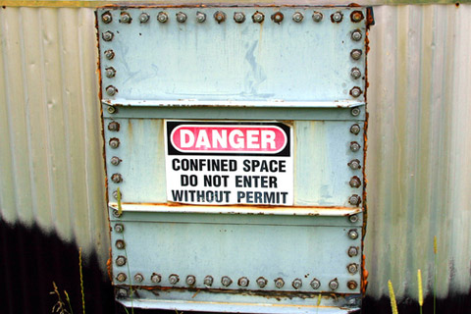
Confined Spaces
Confined Space hazards can kill you
All confined spaces on TDI vessels are clearly marked
Do not enter without a permit

Slide 28
STOP WORK Authority
All Employees-
regardless of position or time with the company are
Empowered
Encouraged
Expected
To STOP WORK if he or she feels anything is unsafe.

Slide 29
Just before you start work, mentally review:

Slide 30
HSE Special Topic Talks
The ship web pages contains over a hundred short lessons on various health and safety topics.
The vessel chooses one per week to review at the safety meeting.

Slide 31
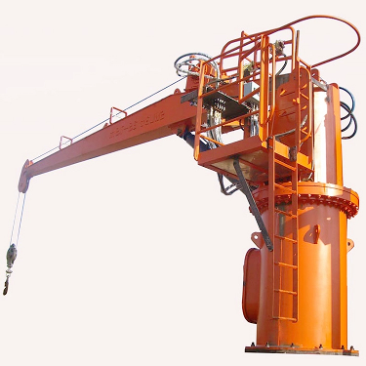
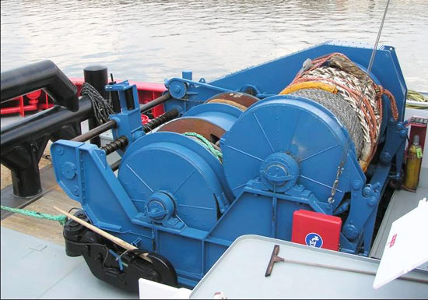
Winch, Crane
Inspections- MUST be completed daily or before each shift by the operator and put in the Winch/ Crane binder

Slide 32
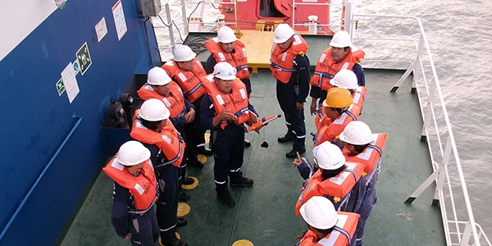
Drills
Drills- ALL persons aboard must participate in drills

Slide 33
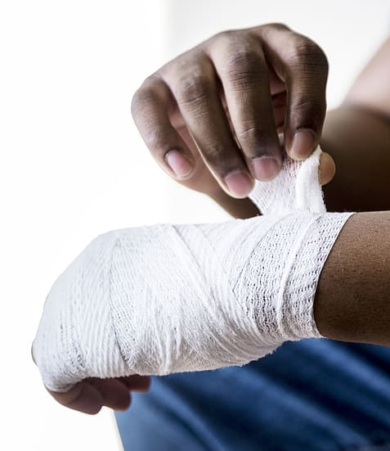
Incident Reporting
Near Miss/ Accidents/ Injuries/ Illness Tell your supervisor, fill out form

Slide 34
Drug and Alcohol Policy
TDI-Brooks has a “ZERO TOLERANCE” for possession or use of any illegal drugs.
TDI-Brooks prohibits illegal drug or alcohol possession and consumption while onboard this vessel at any time.

Slide 35
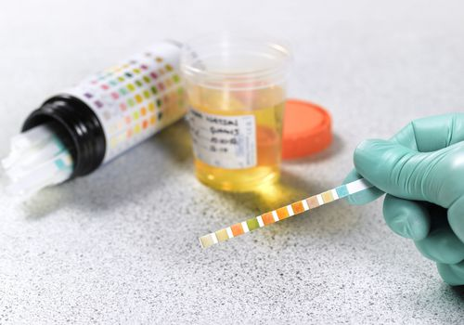
Drug and Alcohol Policy
Any near misses, accidents or suspicious behavior may trigger a drug/alcohol test.

Slide 36
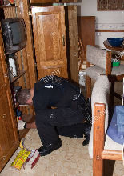
Drug and Alcohol Policy
TDI reserves the right to search persons, their personal effects and vehicles for illegal drugs, alcohol, firearms or possession of unauthorized property or equipment.

Slide 37
Firearms/Weapons Policy
Firearms or any other type of weapon are not permitted aboard this vessel.

Slide 38
Smoking is NOT ALLOWED inside the vessel!!
Smoking is allowed only in designated areas outside the vessel.
No one is permitted to tamper with the smoke detectors on this vessel.
Smoking is not permitted during refueling activities.

Slide 39
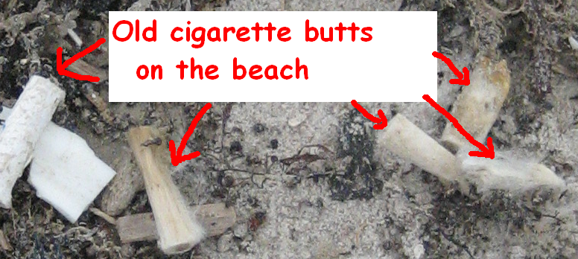
Smoking
Cigarette butts go in ash buckets or receptacles-
Not overboard, Not in trash. ( The filters are made of a plastic called cellulose acetate, NOT paper or cotton and require up to 15 yrs to decompose.)

Slide 40
Waste Management
Nothing goes overboard on this vessel except food wastes, human wastes, and grey water at legal distances from land.

Slide 41
Personal Protective Equipment (PPE)
TDI provides PPE
Wear correct PPE for the task
Ask your supervisor if you need PPE

Slide 42
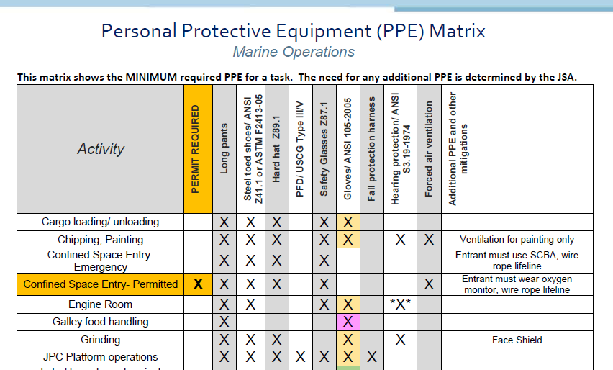
What PPE do I Need?
Check the PPE Matrix
PFD
Hard hat

Slide 43
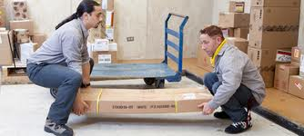
Manual Lifting Guidelines
Lifting guidelines are designed to reduce back injuries associated with manual lifting, placing, carrying, holding and lowering.
If you have some condition that may limit your ability to manually move materials, inform your supervisor immediately.

Slide 44
Manual Lifting Guidelines
Get help if the item looks too heavy or awkward.
Make sure you have visibility while carrying objects.
Avoid bending/twisting while lifting.
Get a tight grip on the object before you lift.
Avoid lifting overhead.

Slide 45
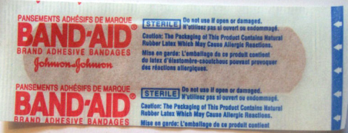
Health Issues
Tell your supervisor if you are taking medication or have a condition that could affect your ability to work safely.
Complete the Medical Disclosure form in case of emergency.
Each vessel has basic first aid kits and over the counter medications.

Slide 46
Health Issues- Food Allergies
If you have food allergies, notify the cook and the HSE Officer on board.
If your allergies are severe, do you have an EpiPen? Make sure the HSE Officer or medic knows where this is if you need it.
TDI-BI Safety at Sea May 2012

Slide 47
Short-Service Employees (SSE)
Short-Service Employees
An individual who has worked less than 6 months for TDI-Brooks or in that position
(An experienced lab guy moved to deck is a new guy on deck)

Slide 48
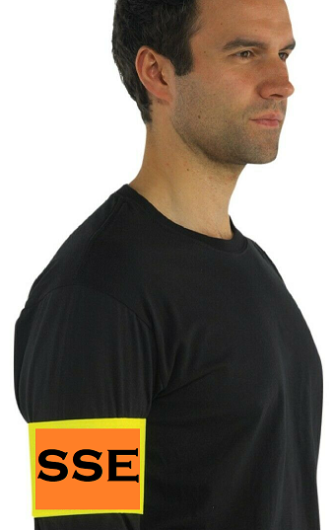
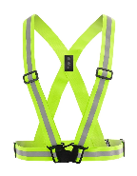
Short-Service Employees (SSE)
Will be visually identified by a different colored hard hat, armband or shirt color.
What is the identifier for SSE’s on this job?

Slide 49
SSE Mentors
Mentors are fully trained, experienced employees responsible for ensuring SSEs will:
Only do work they have been trained for
Perform work in a safe manner
Follow TDI HSE policies and procedures

Slide 50
Assign Mentors to SSEs
Who are the SSE’s in this meeting? (Less than 6 months in current position)
Assign mentors at the end of this meeting and document on the sign in sheet.

